Slide 1


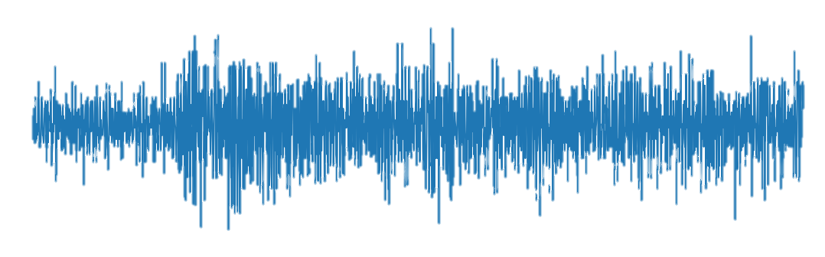
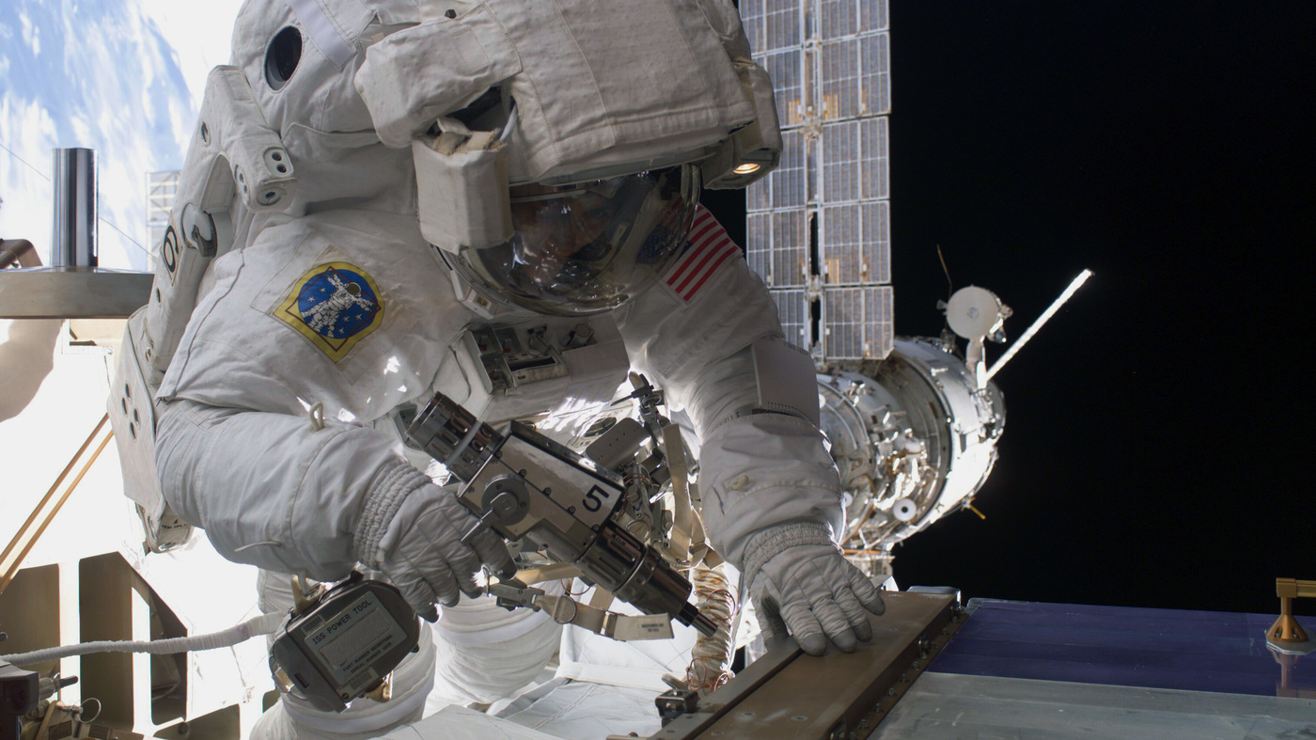
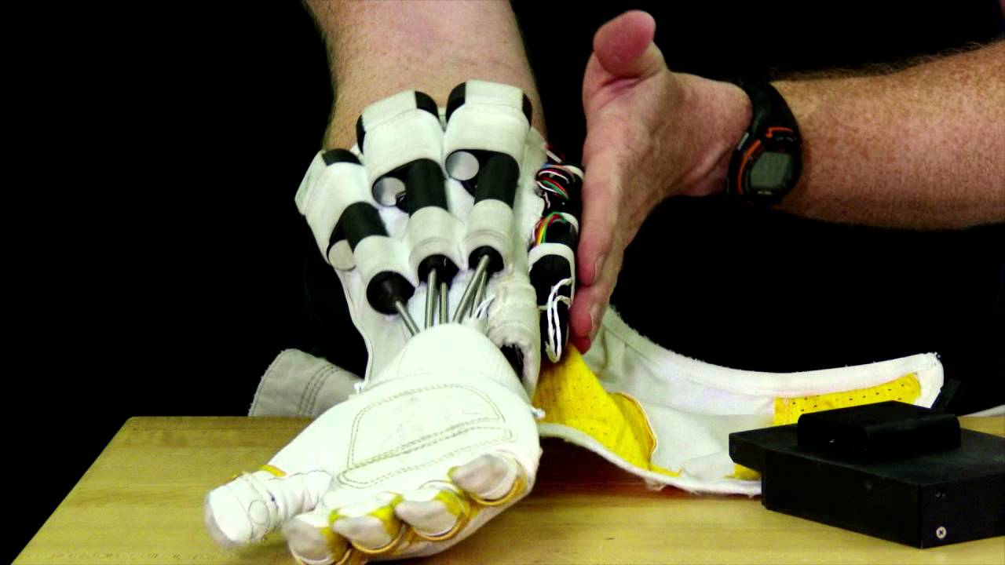
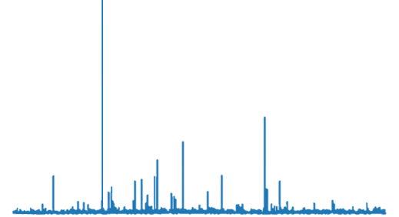
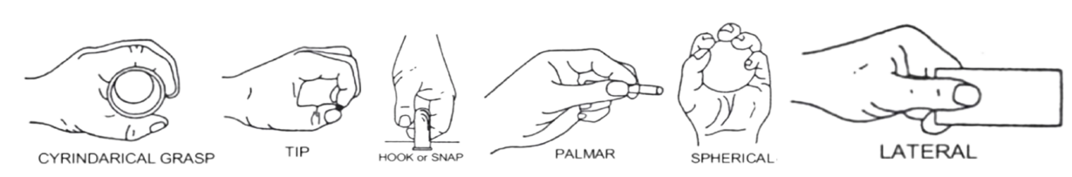

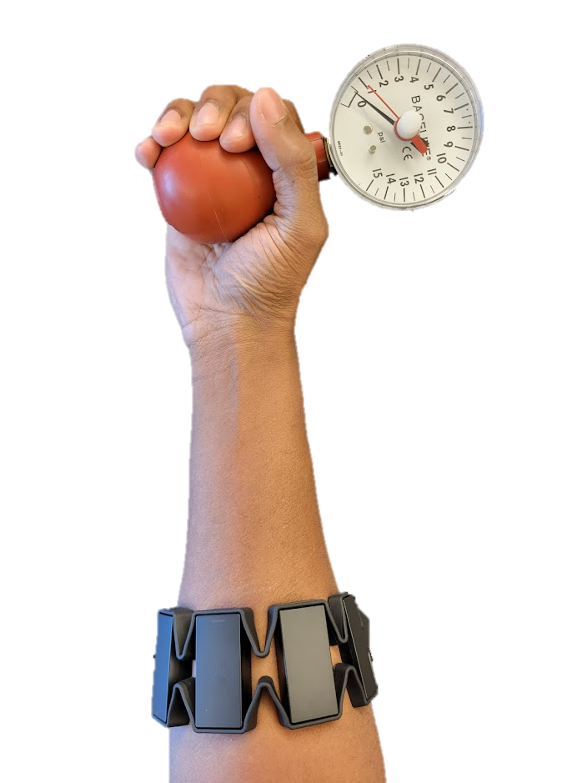
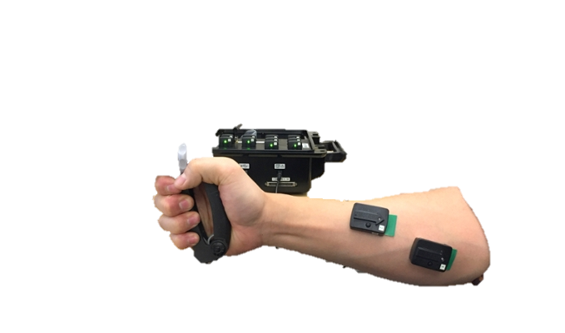
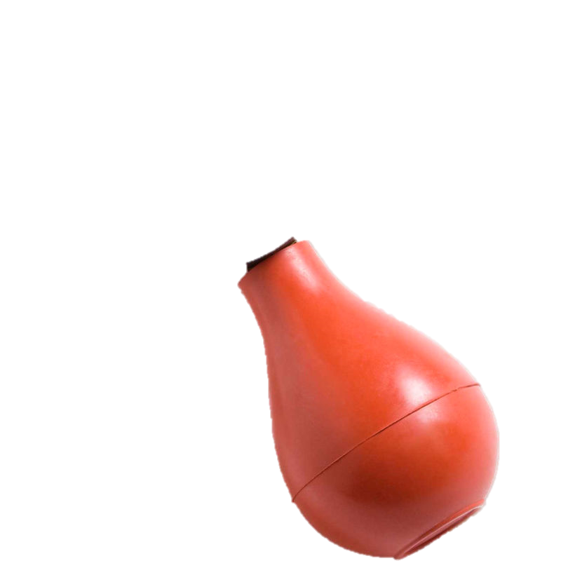
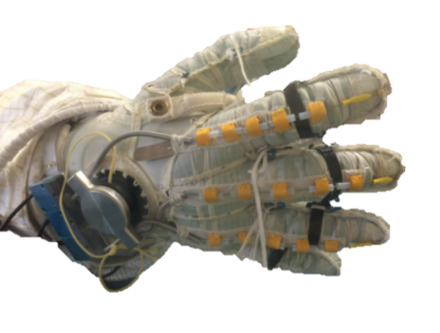
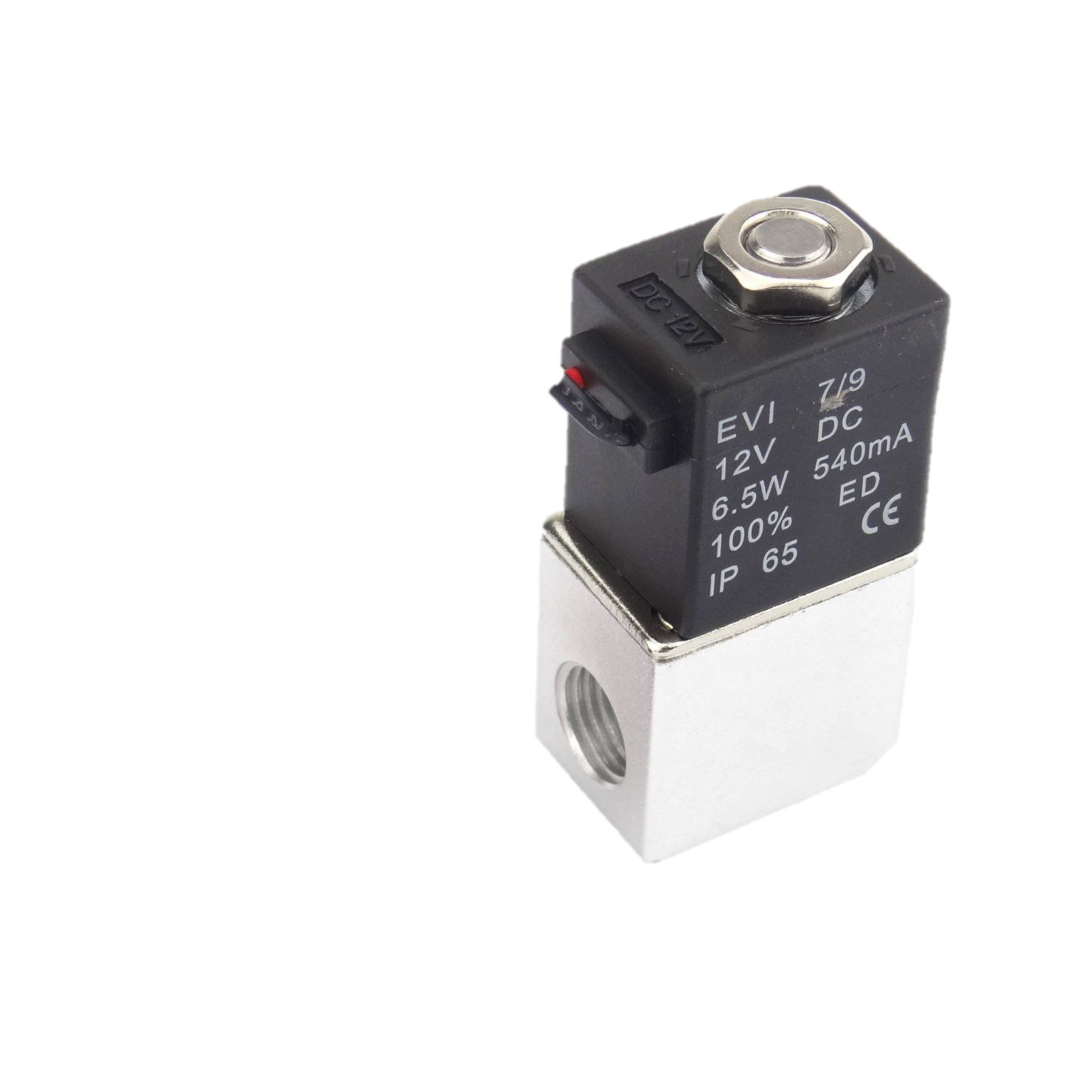
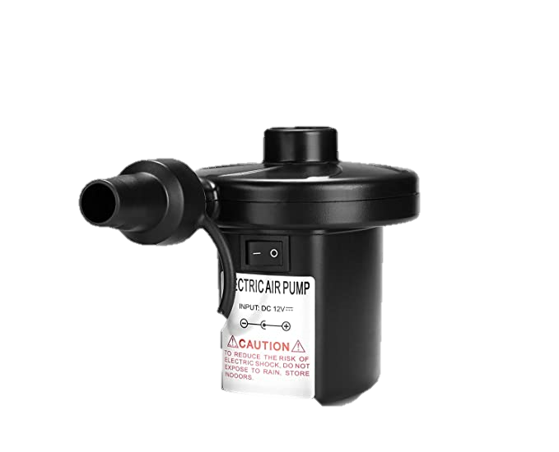
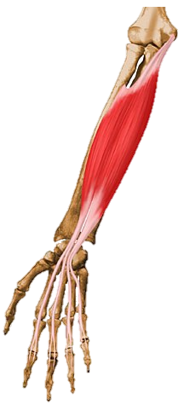
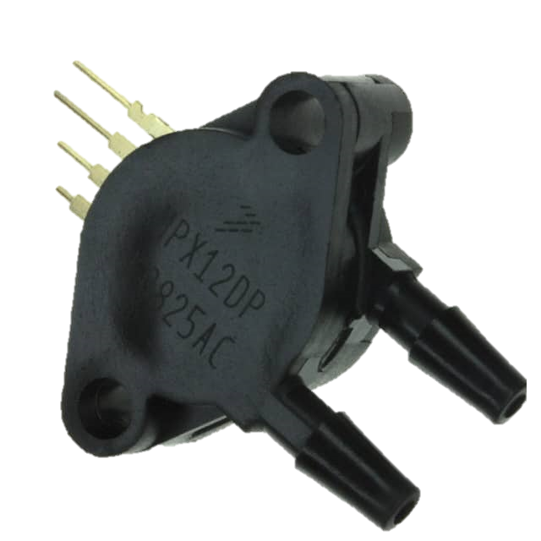
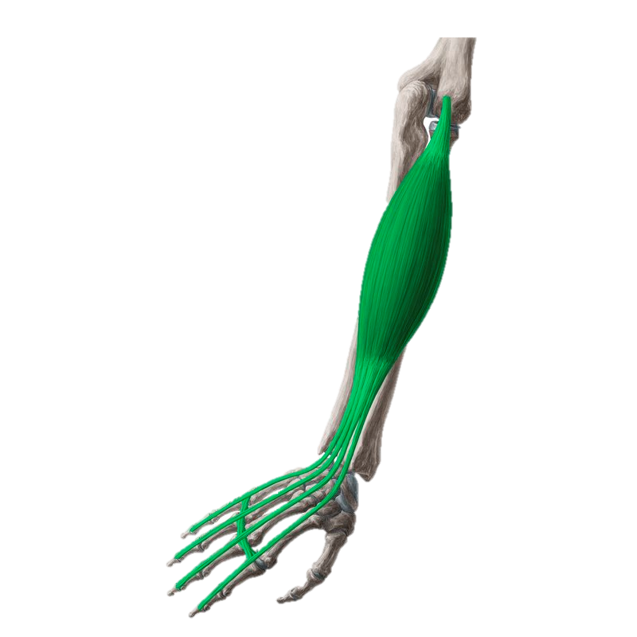

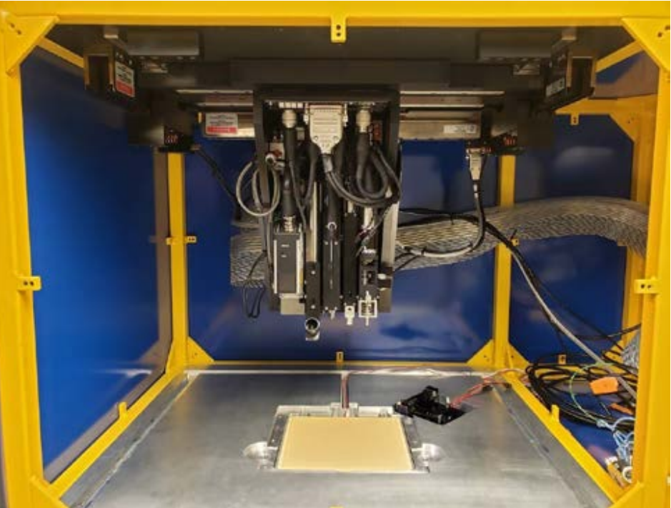

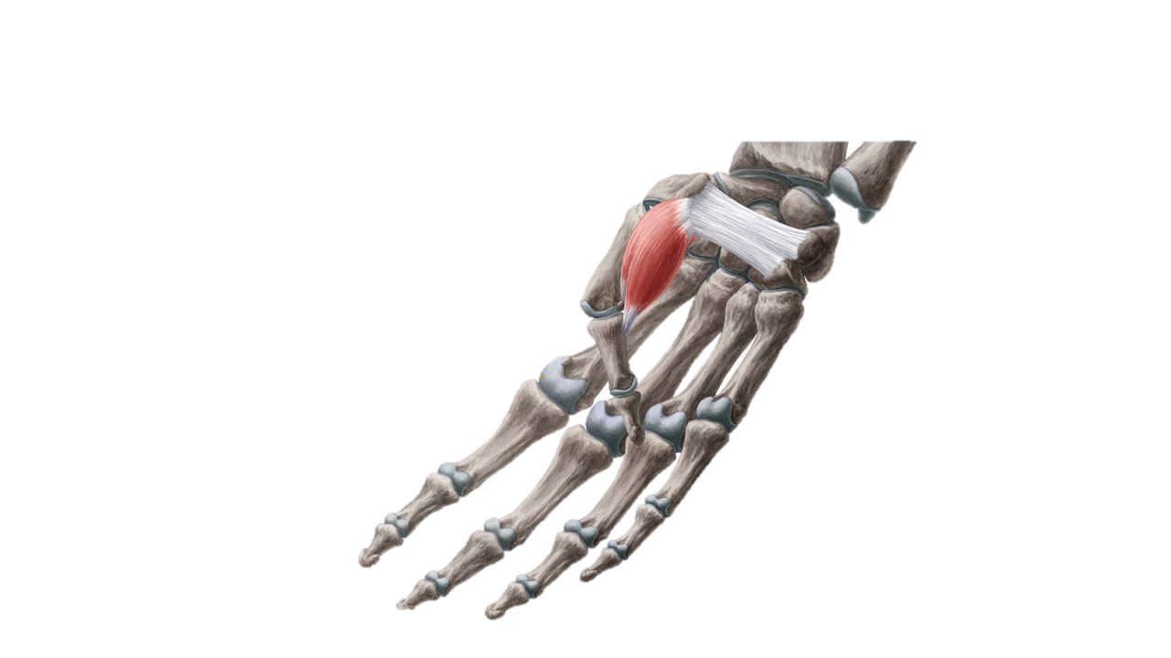
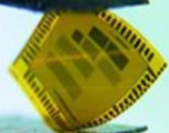
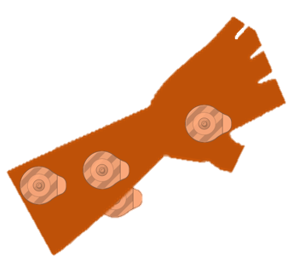
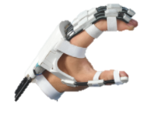
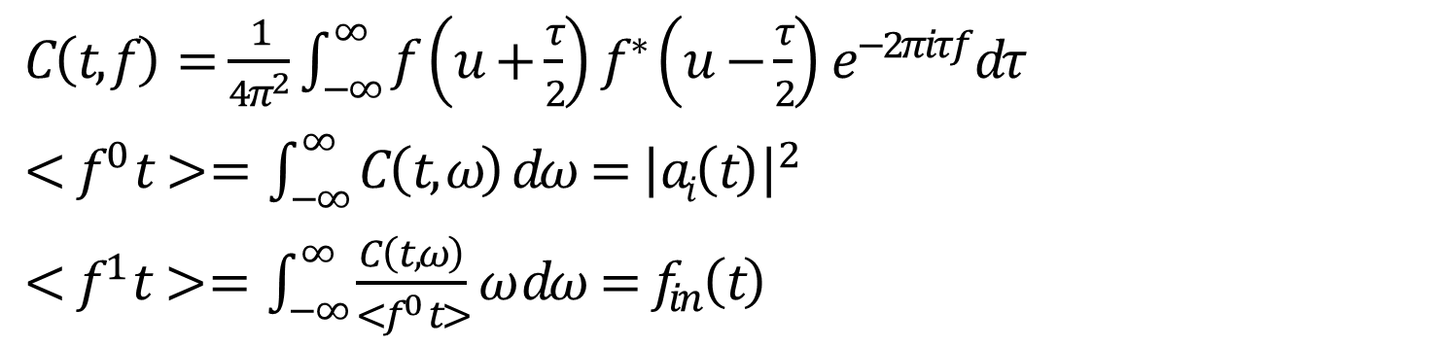
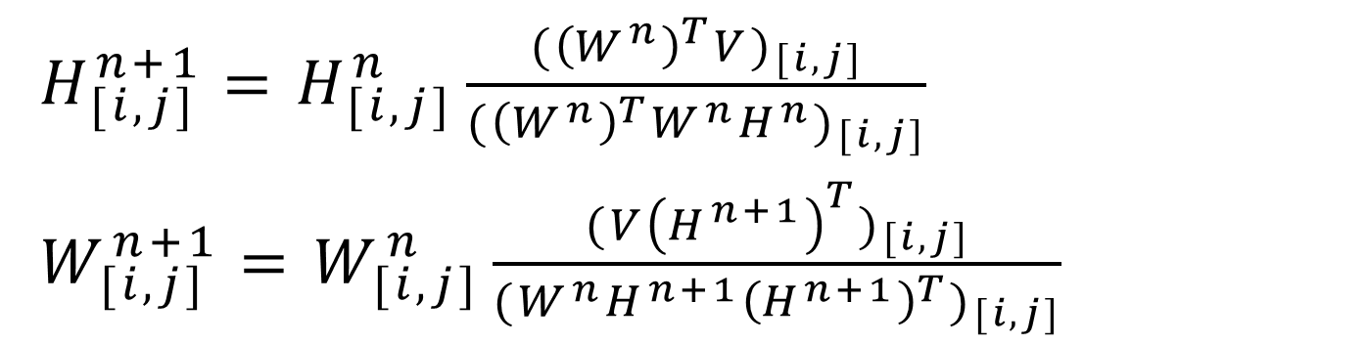
TOWARD THE FUTURE OF MANNED SPACE EXPLORATION
A NOVEL WEARABLE INTERFACE FOR OPTIMAL HUMAN-ROBOT COLLABORATION
Avinash Baskaran and Chad G. Rose
Department of Mechanical Engineering, Auburn University
BACKGROUND
IMPLEMENTATION
Human-Robot interaction (HRI) can help astronauts during dangerous or taxing EVAs by providing assistive forces and torques to reduce neuromuscular load
Sub-optimal interaction between humans and robots produces antagonistic forces and torques, diminishing control stability and degrading performance
Modeling fatigue: For non-isometric tasks, sEMG time-frequency spectral characteristics correlate to fatigue
Estimating intent: Decomposition of sEMG signal gives muscles contributions (W_{[i,j]}) to intended movements, (H_{[i,j]}).
To validate the method, an sEMG signal was processed via the intent prediction and fatigue estimation process
Intent & fatigue modeling
Robotic assistance
Hand pose
Intent Prediction Process
$H_{[i,j]}^{n+1}=H_{[i,j]}^{n}\frac{{({\left(W^{n}\right)}^{T}V)}_{[i,j]}}{{({\left(W^{n}\right)}^{T}W^{n}H^{n})}_{[i,j]}}$
$W_{[i,j]}^{n+1}=W_{[i,j]}^{n}\frac{{(V{\left(H^{n+1}\right)}^{T})}_{[i,j]}}{{(W^{n}H^{n+1}{\left(H^{n+1}\right)}^{T})}_{[i,j]}}$
Pose detected
Classifier identifies hand pose
And correlates fatigue with pose to direct robot
Fatigue Estimation Process
$C\left(t,f\right)=\frac{1}{4π^{2}}\int_{−∞}^{∞}{f}\left(u+\frac{τ}{2}\right)f^{∗}\left(u−\frac{τ}{2}\right)e^{−2πiτf}dτ$
$<f^{0} t> = \int_{−∞}^{∞}{C\left(t,ω\right) dω={\left|ai\left(t\right)\right|}^{2}}$
$<f^{1} t> = \int_{−∞}^{∞}{\frac{C\left(t,ω\right)}{<f^{0} t>}ω dω=f_{in}\left(t\right)}$
(left: Astronaut Sunita Williams using a high torque hand-held tool, right: A robotic hand device for assistance during space walks)
Fatigue detected
METHODS
Experimental Validation Protocol
3D printed flexible electrodes embedded in a fabric sleeve will be used to estimate fatigue and movement intent for more optimal human-robot collaboration
Human
Robot
Stage 1. Validation
Stage 2. Comprehensive human subjects trial
Stage 3. Trial w/ spacesuit glove
CONCLUSIONS
Wearable interface
SIGNALS
FORCES
Preliminary results suggest that the interface is able to model both neuromuscular fatigue and movement intent accurately, advancing the state of the art in HRI
target muscles: Flexor digitorum superficialis (top), extensor digitorum (middle), flexor pollicis brevis (bottom)
SIGNALS
3D printed
Flexible sensor electronics
This work meets practical needs in space-suit mounted robotics and human robot interaction more broadly, as no other work has presented such an approach. Future work will include a comprehensive system usability study
REFERENCES
[6] K. E. Madden, A. Deshpande, B. J. Peters, J. M. Rogers, E. A. Laske, and E. McBryan. The influence of robotic assistance on reducing neuromuscular effort and fatigue during extravehicular activity glove use. 2017.
[7] J. Massion, V. Gurfinkel, M. Lipshits, A. Obadia, and K. Popov. [strategy and synergy: two levels of equilibrium control during movement. effects of the microgravity].Comptes rendus de l’Academie des sciences. Serie III, Sciences de la vie, 1992.
[8] K. Min, D. Shin, J. Lee, and S. Kakei. Electromyogram refinement using muscle synergy based regulation of uncertain information. Journal of biomechanics, 2018.
[9] S. A. Overduin, A. d’Avella, J. Roh, and E. Bizzi. Modulation of muscle synergy recruitment in primate grasping. J. of Neuroscience, 2008.
[10] J. Rogers, B. Peters, E. Laske, and E. McBryan. Development and testing of robotically assisted extravehicular activity gloves. 47th International Conference on Environmental Systems, 2017.
[11] C. G. Rose and M. O’Malley. Hybrid rigid-soft hand exoskeleton to assist functional dexterity. IEEE Rbtcs. and Automtn. Letters, 2019.
[12] S. A. Safavynia, G. Torres-Oviedo, and L. Ting. Muscle synergies: Implications for clinical evaluation and rehabilitation of movement. Topics in spinal cord injury rehabilitation, 2011.
[1] S. Boyas and A. Gu evel. Neuromuscular fatigue in healthy muscle: Underlying factors and adaptation mechanisms. Annals of Phys. and Rehab. Med., 2011.
[2] O. Celik, M. O’Malley, C. Boake, H. Levin, N. Yozbatiran, and T. Reistetter. Normalized movement quality measures for therapeutic robots strongly correlate with clinical motor impairment measures. IEEE Trans. on Neural Systems and Rehab. Engineering, 2010.
[4] M. L. Gernhardt, J. A. Jones, R. A. Scheuring, A. F. Abercromby, J. A. Tuxhorn, and J. R. Norcross. Risk of compromised eva performance and crew health due to inadequate eva suit systems. 2009.
[5] E. Jovanov, I. K. Small, T. D. Rolin, H. Ganegoda, and C. Hill. Long term monitoring of respiration and CO2 using flexible printed sensors. 2020.
Funded by: NASA Space Grant Consortium

Slide 2
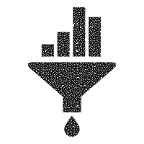



Human-robot interaction plays a key role in healthcare, automation, and military infrastructure, and will continue to enhance human performance in these and other areas.
No standard interface has yet been developed to evaluate and predict muscle fatigue and movement intent.
Probability density of sEMG signal amplitude, a_{i}(t), is analyzed in conjunction with instantaneous frequency, f_{in}(t), to model and predict “neural drive”, a correlate of fatigue that can be modeled
$$<f^{0} t> = \int_{−∞}^{∞}{C\left(t,ω\right) dω={|ai\left(t\right)|}^{2}}$$
$$<f^{1} t> = \int_{−∞}^{∞}{\frac{C(t,ω)}{<f^{0} t>}ω dω=f_{in}(t)}$$
Human
Robot
Fatigue estimation
Joint time-frequency distribution
$$H_{[i,j]}^{n+1}=H_{[i,j]}^{n}\frac{{({\left(W^{n}\right)}^{T}V)}_{[i,j]}}{{({\left(W^{n}\right)}^{T}W^{n}H^{n})}_{[i,j]}}$$
$$W_{[i,j]}^{n+1}=W_{[i,j]}^{n}\frac{{(V{\left(H^{n+1}\right)}^{T})}_{[i,j]}}{{(W^{n}H^{n+1}{\left(H^{n+1}\right)}^{T})}_{[i,j]}}$$
FORCES
Raw sEMG measurements
Filter (10-400 Hz)
Intent estimation
SIGNALS
SIGNALS
Non-negative Matrix Factorization
Decomposition of matrix composed of multiple sEMG signals produces data vectors describing of individual muscle contributions (W_{[i,j]}) to synergistic coactivation patterns (H_{[i,j]})
Sleeve-like wearable sEMG Interface

Slide 3
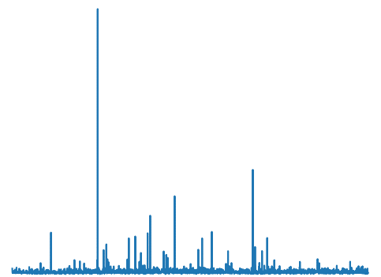
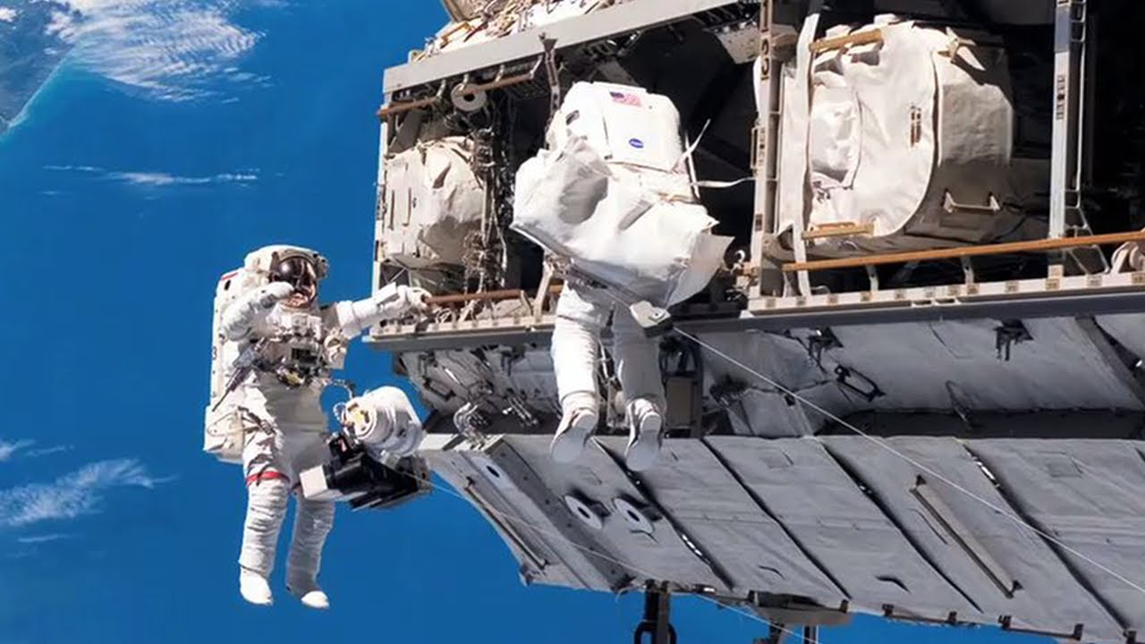

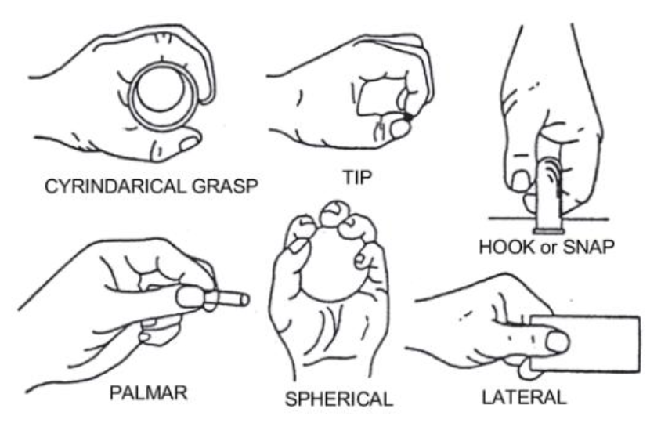

Slide 4

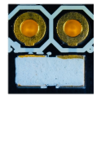

Slide 5
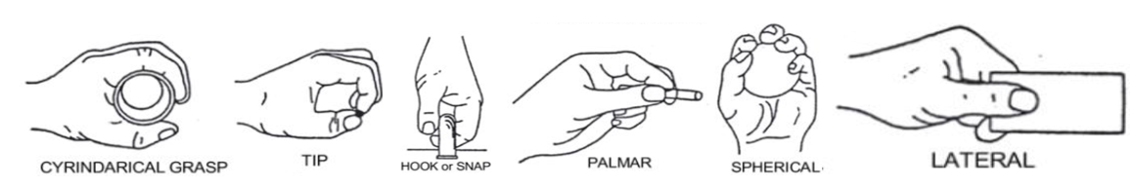

Slide 7
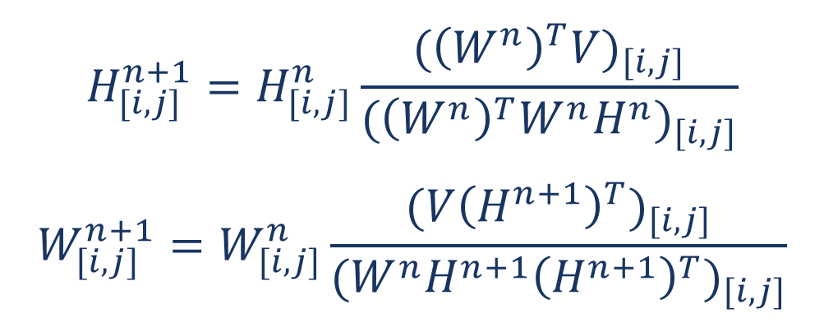
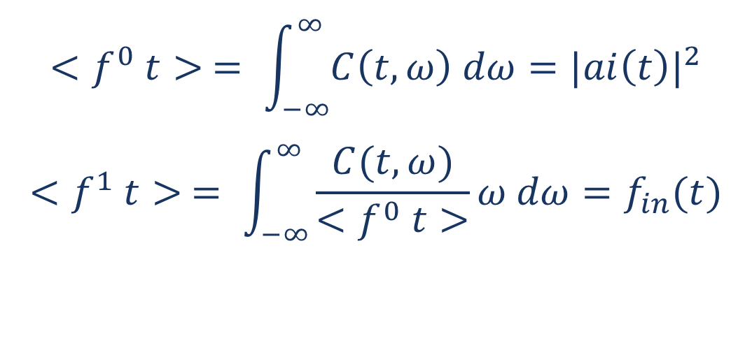
Toward the Future of Manned Space Exploration:
A Novel Wearable Interface for Optimal Human-Robot Collaboration
Avinash Baskaran and Dr. Chad G. Rose
Department of Mechanical Engineering, Auburn University
BACKGROUND
IMPLEMENTATION
Robots can assist astronaut during dangerous or taxing EVAs by providing assistive forces and torques to reduce neuromuscular load.
Sub-optimal interaction between humans and robots due to produces antagonistic forces and torques, diminishing control stability and degrading performance
Processing of the muscle signals includes joint analysis of the probability density of sEMG signal amplitude, a_{i}(t), and instantaneous frequency, f_{in}(t) to model and predict fatigue. Decomposition of sEMG signal matrices will quantify contributions of muscles (W_{[i,j]}) to intended movements models (H_{[i,j]}).
Non-negative Matrix Factorization
Intent estimation
$$H_{[i,j]}^{n+1}=H_{[i,j]}^{n}\frac{{({\left(W^{n}\right)}^{T}V)}_{[i,j]}}{{({\left(W^{n}\right)}^{T}W^{n}H^{n})}_{[i,j]}}$$
$$W_{[i,j]}^{n+1}=W_{[i,j]}^{n}\frac{{(V{\left(H^{n+1}\right)}^{T})}_{[i,j]}}{{(W^{n}H^{n+1}{\left(H^{n+1}\right)}^{T})}_{[i,j]}}$$
Joint time-frequency distribution
Fatigue estimation
$$<f^{0} t> = \int_{−∞}^{∞}{C\left(t,ω\right) dω={|ai\left(t\right)|}^{2}}$$
$$<f^{1} t> = \int_{−∞}^{∞}{\frac{C(t,ω)}{<f^{0} t>}ω dω=f_{in}(t)}$$
(left: Astronaut Sunita Williams using a high torque hand-held tool, right: A robotic hand device for assistance during space walks)
METHODS
A wearable interface embedded with surface electrodes allow for analysis of neuromuscular characteristics including fatigue and intent
CONCLUSIONS
Human
Robot
This work presents a novel human-robot interface which analyzes user fatigue and movement intent using surface electromyography.
reduces garment, It generates and communicates control parameters to wearable robots to minimize their response latency and minimize user fatigue. No other work has presented such an approach, and this work meets a need not only in the literature, but also a felt need in areas such as tele-health and rehabilitation, to Space-suit mounted robotic assistance. Future work includes a comprehensive system usability and efficacy study in a human-subjects context.
SIGNALS
FORCES
SIGNALS
Sleeve-like wearable interface
Flexor digitorum superficialis (left), extensor digitorum (middle), flexor pollicis brevis (right)
REFERENCES
[6] K. E. Madden, A. Deshpande, B. J. Peters, J. M. Rogers, E. A. Laske, and E. McBryan. The influence of robotic assistance on reducing neuromuscular effort and fatigue during extravehicular activity glove use. 2017.
[7] J. Massion, V. Gurfinkel, M. Lipshits, A. Obadia, and K. Popov. [strategy and synergy: two levels of equilibrium control during movement. effects of the microgravity].Comptes rendus de l’Academie des sciences. Serie III, Sciences de la vie, 314 2:87–92, 1992.
[8] K. Min, D. Shin, J. Lee, and S. Kakei. Electromyogram refinement using muscle synergy based regulation of uncertain information. Journal of biomechanics, 72:125–133, 2018.
[9] S. A. Overduin, A. d’Avella, J. Roh, and E. Bizzi. Modulation of muscle synergy recruitment in primate grasping. J. of Neuroscience, 28:880 – 892, 2008.
[10] J. Rogers, B. Peters, E. Laske, and E. McBryan. Development and testing of robotically assisted extravehicular activity gloves. 47th International Conference on Environmental Systems, 2017.
[11] C. G. Rose and M. O’Malley. Hybrid rigid-soft hand exoskeleton to assist functional dexterity. IEEE Robotics and Automation Letters,4:73–80, 2019.
[12] S. A. Safavynia, G. Torres-Oviedo, and L. Ting. Muscle synergies: Implications for clinical evaluation and rehabilitation of movement. Topics in spinal cord injury rehabilitation, 17 1:16–24, 2011.
[1] S. Boyas and A. Gu evel. Neuromuscular fatigue in healthy muscle: Underlying factors and adaptation mechanisms. Annals of Phys. and Rehab. Med., 2011.
[2] O. Celik, M. O’Malley, C. Boake, H. Levin, N. Yozbatiran, and T. Reistetter. Normalized movement quality measures for therapeutic robots strongly correlate with clinical motor impairment measures. IEEE Trans. on Neural Systems and Rehab. Engineering, 2010.
[4] M. L. Gernhardt, J. A. Jones, R. A. Scheuring, A. F. Abercromby, J. A. Tuxhorn, and J. R. Norcross. Risk of compromised eva performance and crew health due to inadequate eva suit systems. 2009.
[5] E. Jovanov, I. K. Small, T. D. Rolin, H. Ganegoda, and C. Hill. Long term monitoring of respiration and co2 using flexible printed sensors. 2020.
Funded by: NASA Space Grant College and Fellowship Program

